Slide 1

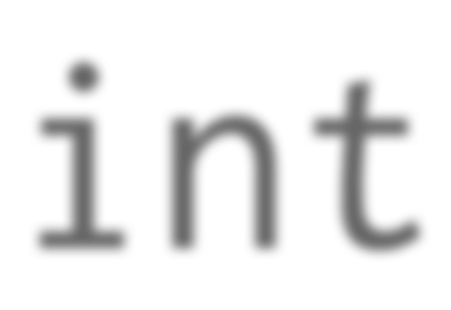
int
unlimited precision signed integer

Slide 2
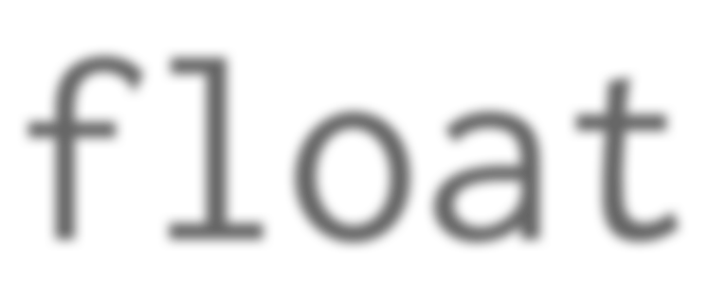
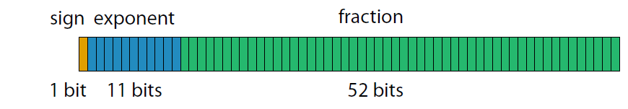
float
IEEE-754 double precision (64-bit)
53 bits of binary precision
15 to 17 bits of decimal precision

Slide 3

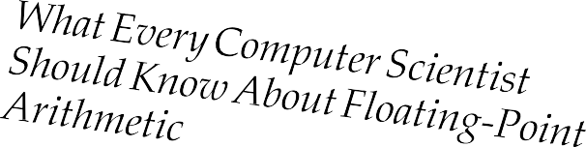
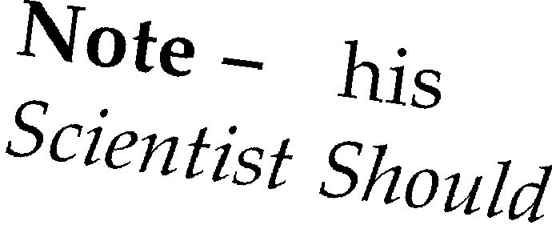
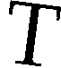
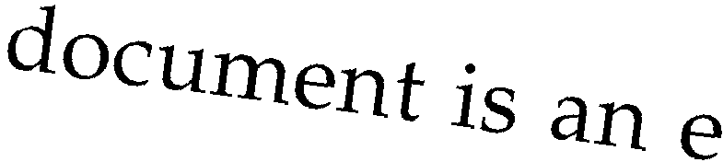

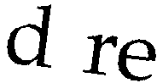
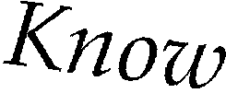
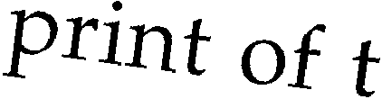
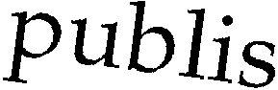

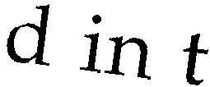
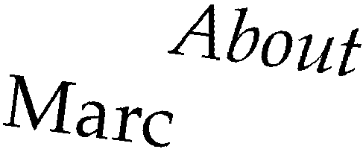
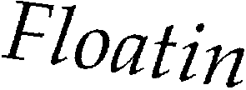
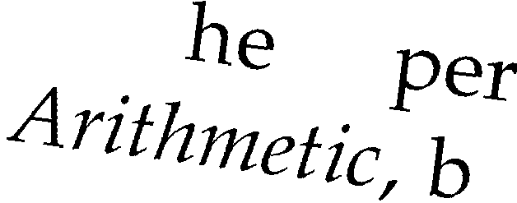
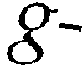
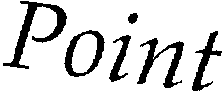
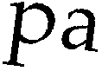
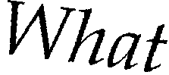
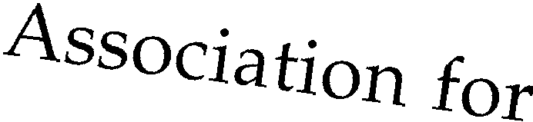
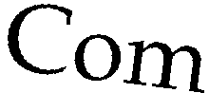
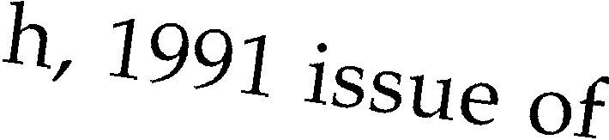
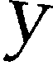
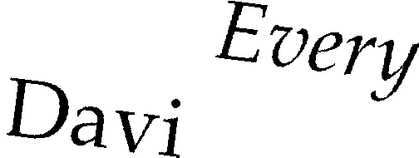
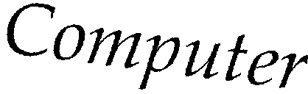
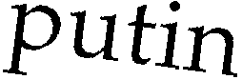
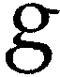
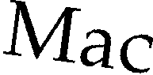

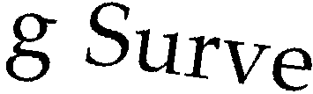
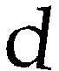

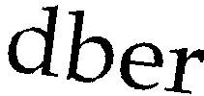
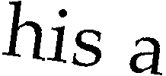
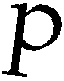
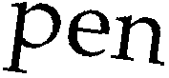
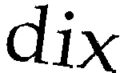
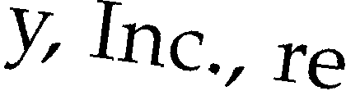
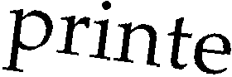
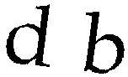
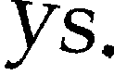
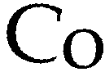
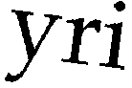
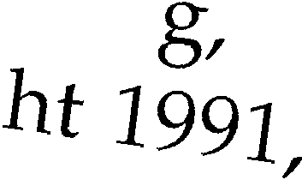
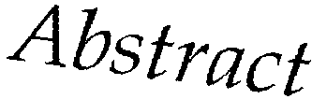
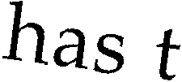
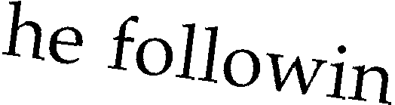
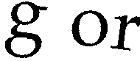
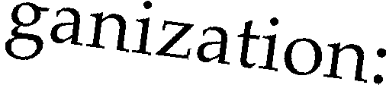
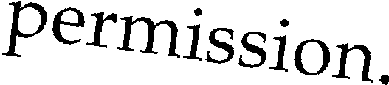
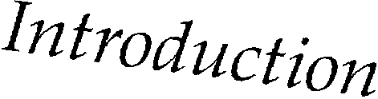
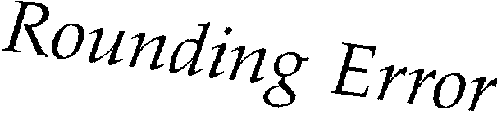























David Goldberg
Journal ACM Computing Surveys (CSUR) Volume 23 Issue 1, March 1991
Pages 5-48

Slide 4



The standard library module
decimal
containing the class
Decimal
decimal floating point configurable (although finite) precision defaults to 28 digits of decimal precision

Slide 5



Decimal(0.8) - Decimal(0.7)
0.8
0.7
0011111111101001100110011001100110011001100110011001100110011010
0011111111100110011001100110011001100110011001100110011001100110
0.8000000000000000444089209850062616169452667236328125
0.6999999999999999555910790149937383830547332763671875
0.1000000000000000888178419700
always quote literal
fractional values

Slide 6

>>> (-7) % 3
2
2
−10 −9 −8 −7 −6 −5 −4 −3 −2 −1 0
1
2
3
ANSI/IEEE Std 854-1987
An American National Standard
>>> Decimal(-7) % Decimal(3) Decimal('-1')
−1
IEEE Standard for Radix-Independent
Floating-Point Arithmetic
Sponsor
^{Technical Com}mittee on Microprocessors and Microcomputers
of the
IEEE Computer Society
^{Appro}ved March 12, 1987
^{Reaf}firmed March 17, 1994
IEEE Standards Board
^{Approved S}eptember 10, 1987
^{Reaf}firmed August 23, 1994
^{American Na}tional Standards Institute
© Copyright 1987 by
−10 −9 −8 −7 −6 −5 −4 −3 −2 −1 0
1
2
3
^{The Instit}ute of Electrical and Electronics Engin_{eers, Inc}
^{345 East 47th Street, New Yor}k, NY 10017, USA
No part of this publication may be reproduced in any form, in an electronic retrieval system or otherwise, without _{the}
^{prior written permis}sion of the publisher.
i

Slide 7

This important identity is preserved
x == (x // y) * y + x % y
so integer division and modulus are consistent

Slide 8




>>> (-7) // 3
-3
−3
3
3
3
−10 −9 −8 −7 −6 −5 −4 −3 −2 −1 0
1
2
3
>>> Decimal(-7) // Decimal(3) Decimal('-2')
−2
The floor division
// is a
operator
Decimal
misnomer for
3
3
−10 −9 −8 −7 −6 −5
−4 −3 −2 −1 0
1
2
3

Slide 9















fractions
The standard library module
denominator
cannot be
containing the class
Fraction
for rational numbers
zero
numerator
⅔
⅘
denominator

Slide 10

The built-in type
complex
for complex numbers

Slide 11

The built-in function
abs()
gives the distance from zero

Slide 12


The built-in function
round()
performs decimal rounding for all scalar number types

Slide 13




Number base conversions
bin()
base 2
oct()
base 8
hex()
base 16
int(x, base)
bases 2 to 36

Slide 14



The standard library module
datetime

Slide 15













date
Gregorian Calendar
year month day
proleptic
datetime
year month day hour minute second
microsecond
1
−∞ ← now → +∞
time
naïve aware
1 hour minute second
microsecond
0..1
tzinfo
timezone
utcoffset()
timedelta
days seconds
microseconds
immutable

Slide 16











year:
1-9999
month: 1-12
day:
1-31
weekday()
isoweekday()
0
Monday
1 Monday
1
Tuesday
2 Tuesday
2
Wednesday
3 Wednesday
3
Thursday
4 Thursday
4
Friday
Friday
5
5
Saturday
Saturday
6
6
Sunday
Sunday
7
ISO 8601:2004
Representation of
dates and times

Slide 17

timeanddate.com

Slide 18


Slide 19


Slide 20

Numeric and Scalar Types
int float
sys.float_info
complex("3+4j")
from decimal import Decimal
£ $ ¥
Decimal % → 0 int, float % → −∞
abs(-5) round(0.6) bin(100) oct(100) hex(100)
int("100", base=5)
from fractions import Fraction f = Fraction("2/3")
from datetime import (date, time)
from datetime import datetime as Datetime
from datetime import timedelta
from datetime import (tzinfo, timezone)

